Slide 1

Lariat Rental FY2019 Business Optimization Plan

Slide 2
Overall Health of Lariat

Slide 3
Overall Health of Lariat
Good, but could be better!

Slide 4
Overall Health of Lariat
Good, but could be better!
Current profit margin of 37.39%
Significant room for cost-side improvement and potential revenue growth
Analyzed customers, branches, fleet, and markets

Slide 5
Customer & Branch Analysis
No significant difference in customer preferences.
Most branches are performing well!
Customers rent equally at both types of branches.
Similar rental length at both types of branches.
Similar distribution of gender, age, and accident rate from renters at both types of branches.
If excess demand for car rentals exists, favorable expansion prospects!
Graph showing revenue per rental vs. airport and non-airport locations

Slide 6
Fleet Analysis

Slide 7
Fleet Analysis
Fleet is too large!

Slide 8
Fleet Analysis
Fleet is too large!
Only 22% Utilization rate
4000 Cars, 73 Makes (Top 10 = 50%)
Significant opportunity to consolidate operations to boost profit margins

Slide 9
Business Optimization
Primary KPI is fleet utilization!
Rentals have average profit margin of 37%: do not worry about profitability!
Profits
Revenue
# of Rentals
Price Per Rental
Cost
Cost per Car
# of Cars in Fleet
Fleet
Utilization %

Slide 10

1: Slim the fleet
Remove cars that are underutilized and do not make as much money!
With a new fleet size of approx. 1800 cars:
Estimated cost reduction of $18M each year, 48% utilization
Improves profit margin to 71%
Does not require large changes in current operations; no fulfillment risk
Potential for even higher utilization %

Slide 11
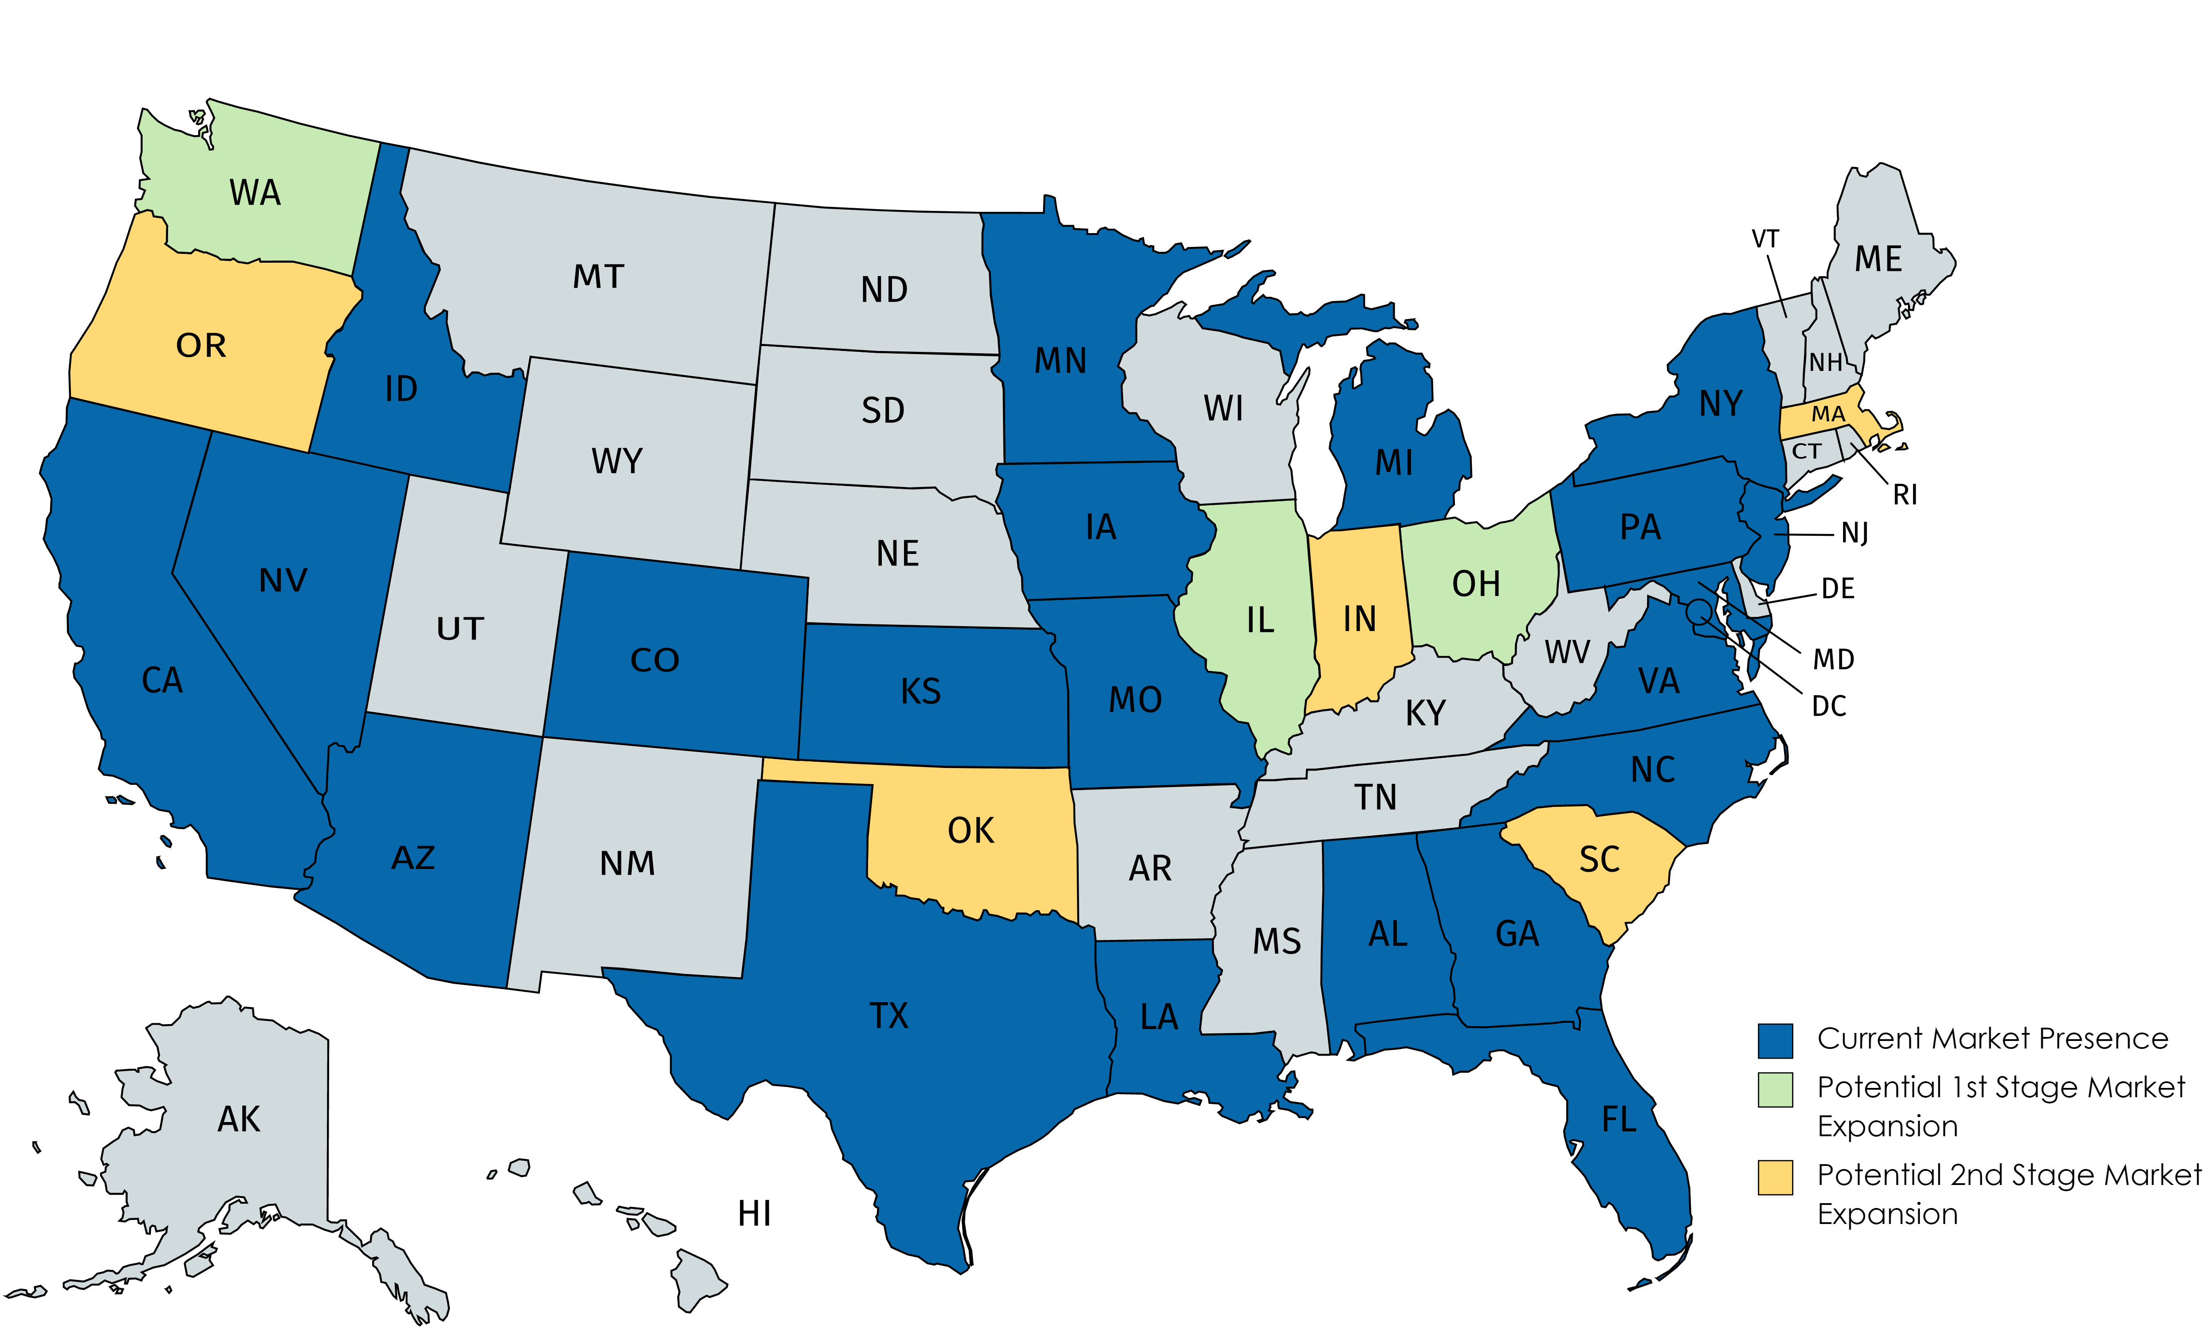
2: Explore new branches
Average 1600 Rentals per branch per year
Initial assessment suggests exploring high-population areas and underserved markets

Slide 12
Expected Results

Slide 13
Implementation & Next Steps
Implement the fleet reduction
Explore branch expansion opportunities (both new and underserved markets)

Slide 14
Implementation & Next Steps
Benchmark prices vs. competitors and explore discounts/partnerships to boost rentals
Consider consolidating purchasing agreements for additional discounts
Profits
Revenue
# of Rentals
Price Per Rental
Cost
Cost per Car
# of Cars in Fleet
Fleet
Utilization %

